Slide 1
The XDC project
Giacinto DONVITO
XDC – Technical Coordinator
INFN
donvito@infn.it

Slide 2
Outline
XDC introduction and objectives
The XDC-1/Pulsar Release: the first year achievements
Next Steps && Conclusion

Slide 3
XDC
The eXtreme DataCloud is a software development and integration project
Develops scalable technologies for federating storage resources and managing data in highly distributed computing environments
  Focus on efficient, policy driven and Quality of Service based DM
The targeted platforms are the current and next generation e-Infrastructures deployed in Europe
  European Open Science Cloud (EOSC)
  The e-infrastructures used by the represented communities
Addresses the EINFRA-21-2017 (b)-2: “Computing e-infrastructure with extreme large datasets”
  Deal with heterogeneous datasets
  Bring to TRL8 and include in a unified service catalogue services and prototype at least at TRL6

Slide 4
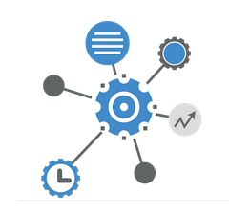
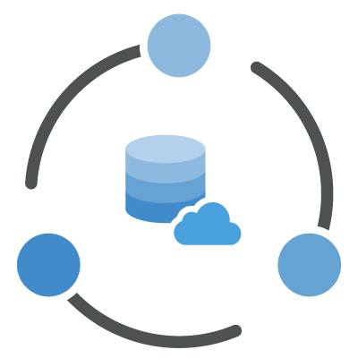
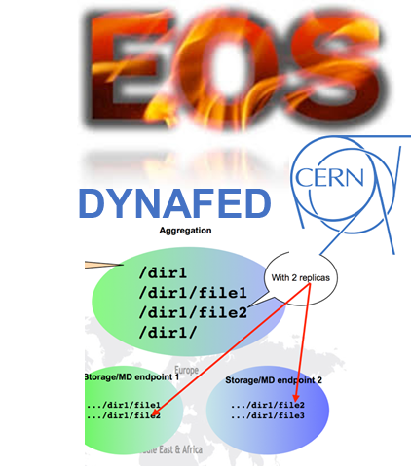


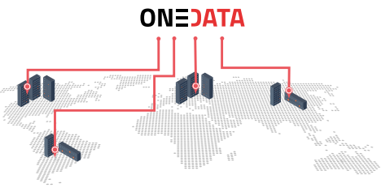






The Approach
Improve already existing, production quality Data Management services
  By adding missing functionalities requested by research communities
  Based mainly on technologies provided by the partners and by the INDIGO-Datacloud project
  Must be coherently harmonized in the European e-Infrastructures
FTS
INDIGO PaaS Orchestrator
INDIGO CDMI Server

Slide 5
XDC Approach
The partners owning/involved in each of the tools are the main developers for that solution in XDC
We always aim to push back the code in the main development tree on the original projects
  This widely increase the sustainability of the services
Upstream repositories
XDC new features

Slide 6
XDC standards and protocols
We always rely on standard and widely adopted protocols for services-to-services and for user-to-services interaction
Functionalities | Standards
Access/transport | http/webdav, gridftp, etc
Metadata | RDF, JSON
Orchestrating services | TOSCA, Ansible
Application sw distribution | Docker
AAI | OpenIDConnect, X509
Storage QoS | SNIA CDMI
Inter process communication | REST APIs, SSE, Message bus
This concretely opens the possibility to interact with external services
  At the infrastructure level we provide few reference implementations
  others services/initiative are implementing the same functionalities using same standard/protocols

Slide 7

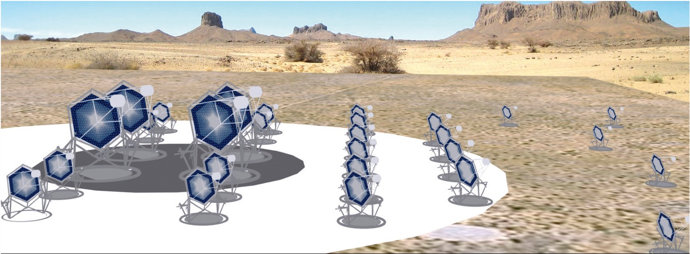
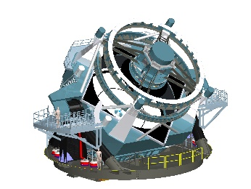
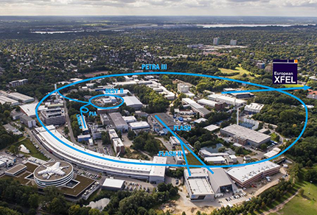



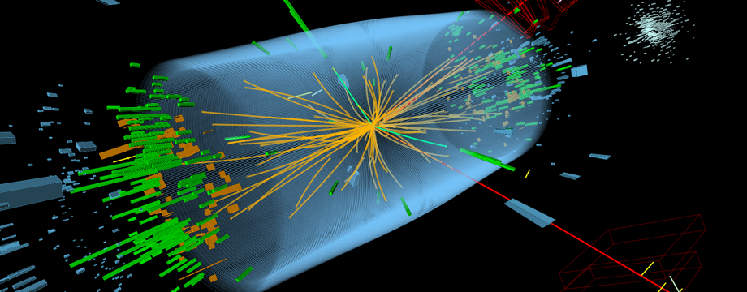


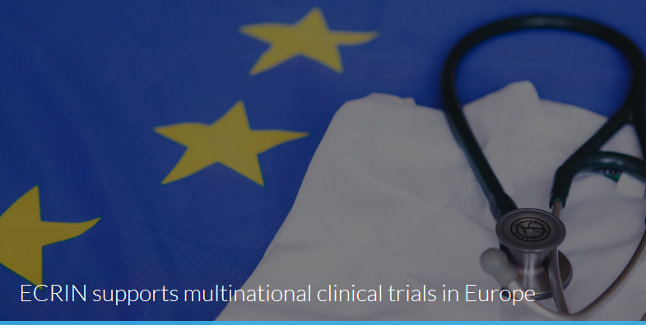

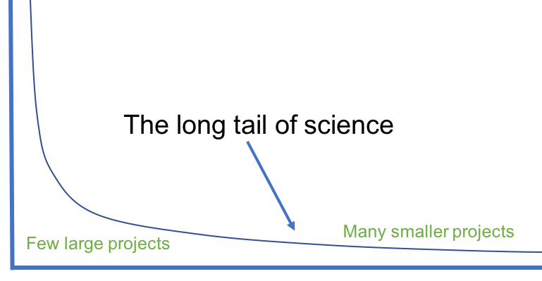
A User Driven Project

Slide 8
XDC Topics
Intelligent & Automated Dataset Distribution
  Orchestration to realize a policy-driven data management
  Data distribution policies based on Quality of Service (i.e. disks vs tape vs SSD) supporting geographical distributed resources (cross-sites)
  Data lifecycle management
Data pre-processing during ingestion
Metadata management
Data management based on storage events
Smart caching
  Transparent access to remote data without the need of a-priori copy
    To support dynamic inclusion of diskless sites
    To improve efficiency in multi-site storage systems and storage federations (i.e. Datalakes)
Sensitive data handling
  secure storage and encryption

Slide 9
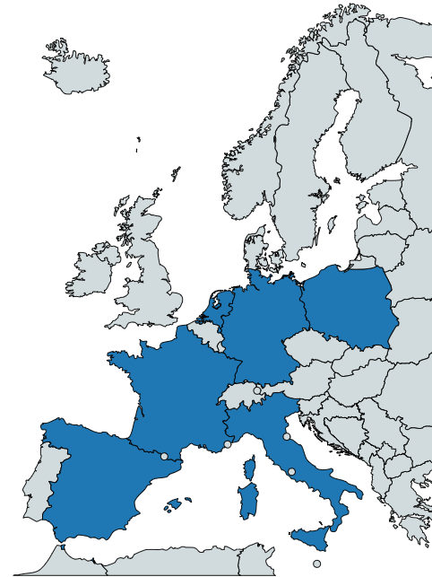
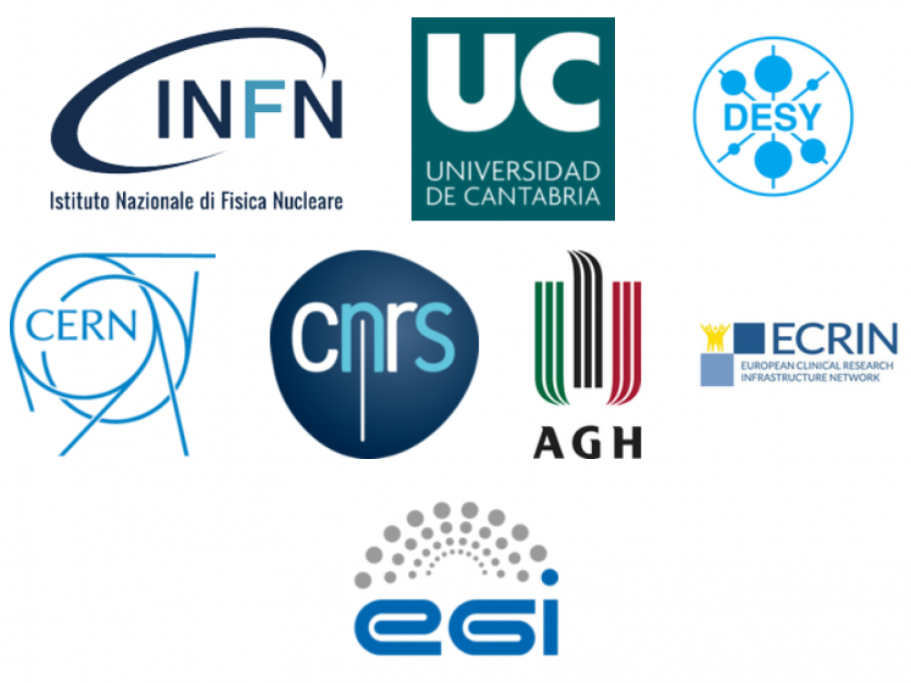
XDC Consortium
ID | Partner | Country | Represented Community | Tools and system
1 | INFN (Lead) | IT | HEP/WLCG | INDIGO-Orchestrator
2 | DESY | DE | Research with Photons (XFEL) | dCache
3 | CERN | CH | HEP/WLCG | EOS, DYNAFED, FTS, RUCIO
4 | AGH | PL |  | ONEDATA
5 | ECRIN | [ERIC] | Medical data
6 | UC | ES | Lifewatch
7 | CNRS | FR | Astro [CTA and LSST]
8 | EGI.eu | NL | EGI communities
8 partners, 7 countries
6 research communities represented + EGI
XDC Total Budget: 3.07Meuros

Slide 10
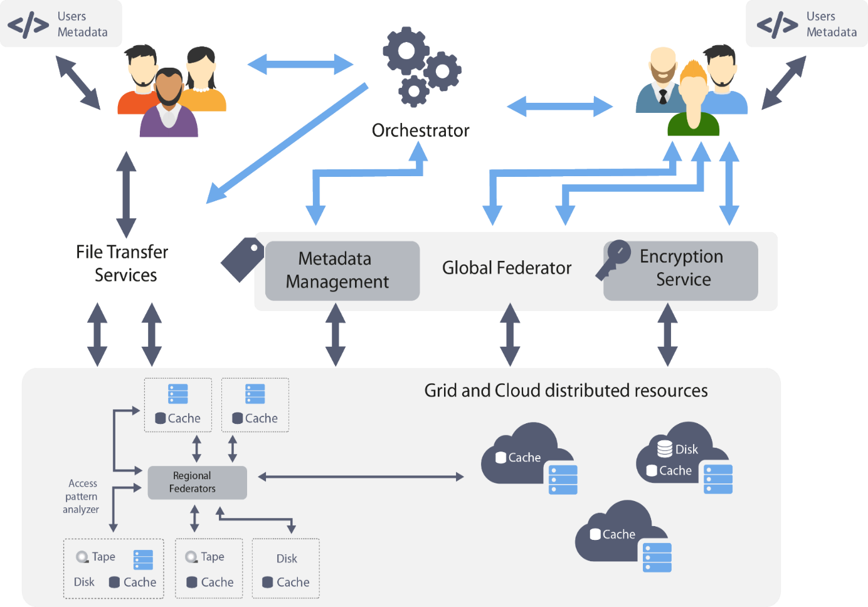
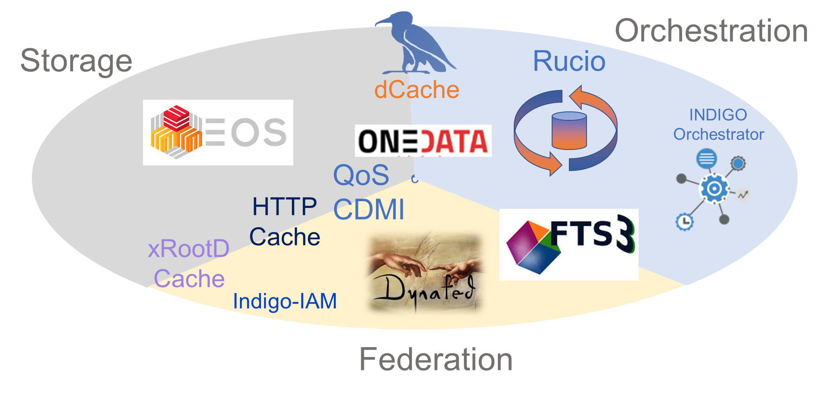
General Architecture Definition
XDC acts at all the e-infrastructure levels
  Storage systems at sites
  Federations of storage systems
    regional and global
  High level orchestration
  User experience
The “toolbox” was mapped in those levels to define the general architecture
  Taking into account the user requirements
The XDC Toolbox

Slide 11



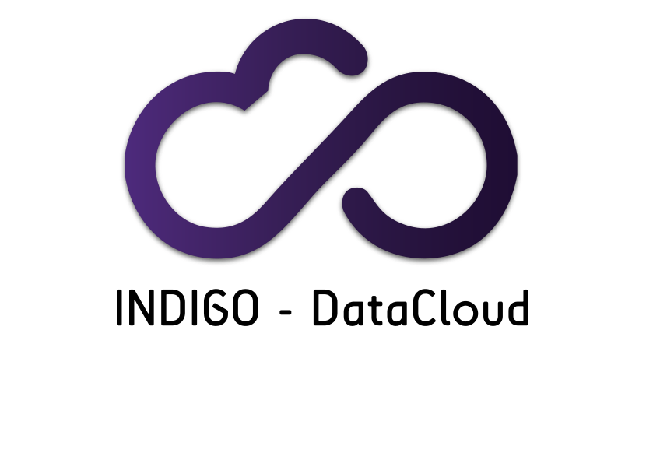

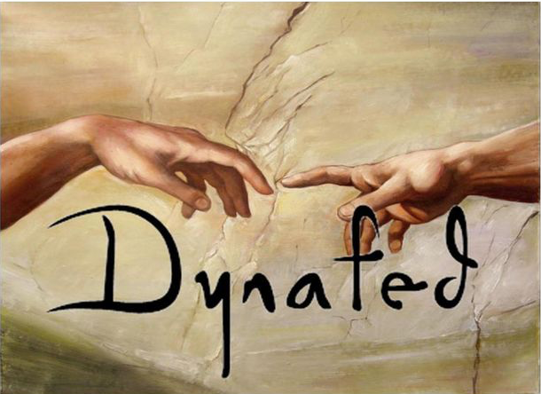
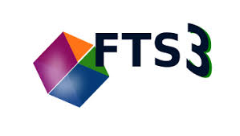





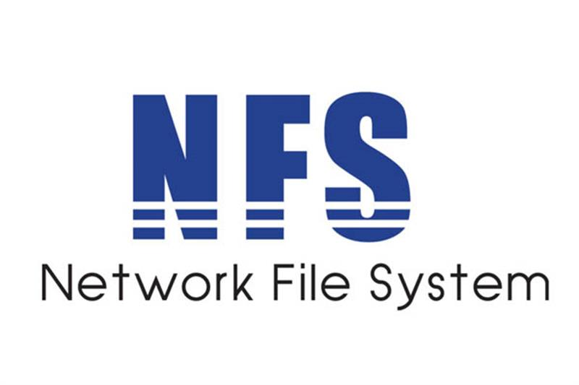



XDC General Architecture
Users
AAI Service
IAM
Storage Orchestration
User
metadata service
INDIGO
PaaS orchestrator
Storage Federation
XDC message bus
Platform Event collection
Reliable File Transfer Service
Storage Resources
Storage system at sites

Slide 12





Connection to external Entities
DEEP-DataCloud
  Connection to compute workloads
DOMA (Data Organization, Management, Access)
  DOMA “Access”
  DOMA “QoS” (XDC Workgroup Leader)
  DOMA “3rd Party Copy”
ESCAPE – WP2 (XDC Task Leader)
  Deployment of a European Data Lake
RDA
  Defining QoS vocabulary
SNIA
  Rendering CDMI to reflect QoS
  XDC introduced at 2018 SNIA conference

Slide 13

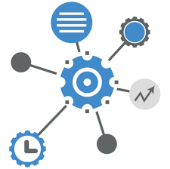



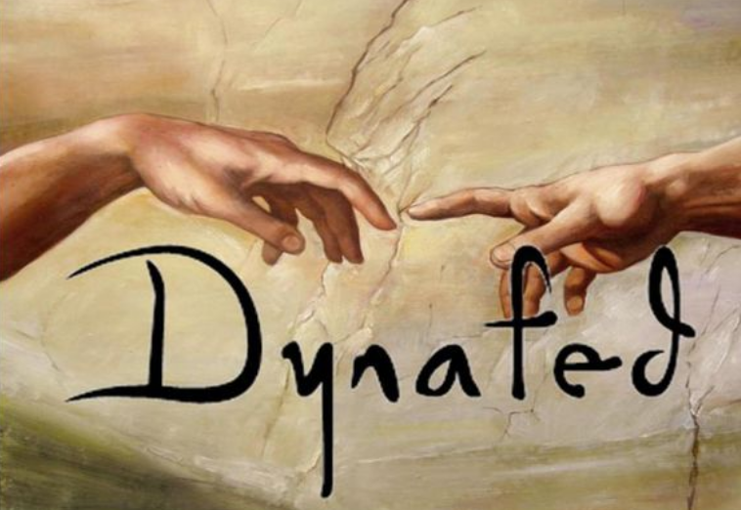



XDC Components
The Components
Orchestration and Federation Components
  XDC Orchestrator
    INDIGO PaaS Orchestrator
    Flowable © (BPM)
    Rucio Data Management System
Data Transfer and Data Federation technologies
  FTS, File Transfer Service,
  Dynafed, Data Federator, Onedata
Storage Systems
  dCache
  EOS
  StoRM

Slide 14
XDC Orchestration Components
INDIGO PaaS Orchestrator
  Based on INDIGO-DataCloud developments.
  Allows to coordinate complex deployments on hybrid clouds featuring advanced scheduling and federation capabilities
  Orchestrates compute resources and provides data-aware scheduling of jobs through data placement plugins (XDC extensions)
  Integrates with Rucio for data location and transfer orchestration (XDC developments)
  Operates with an professional BPM system. (Flowable)
Flowable © (BPM)
  Provides a workflow and Business Process Management (BPM) platform for developers, system admins and business users
Rucio
  Originally LHC ALTAS data management tools.
  Recently adopted by a growing number of other communities.
  Already provides interfaces to most XDC components

Slide 15
XDC Transport Components
The Components
FTS, File Transfer Service
  WLCG data transfer workhorse.
  Transfers around 1 Exabytes of WLCG data per year between hundreds of storage sites around the word.
  Performs request queueing and network shaping.
  Can be used as “micro service” or with GUI (WebFTS).
  Support X509 and token based authentication for endpoints.
Dynafed, Data Federator
  Federates storage endpoints to a single root namespace.
  Supported Protocols: http/WebDAV, S3.
  Performs metadata prefetching.
  Provides location meta data to high level services.

Slide 16
XDC Storage Components
The Components
dCache
  Open Source Storage system provided by DESY, Fermilab and NDGF.
  Handling 150 PBytes at more than 60 big data centers, including 7 WLCG Tier 1 centers.
  Supports industry standard data access and security protocols on top of a geo-aware multi tier storage stack.
EOS
  Scalable storage running at CERN and elsewhere.
  Geo-aware management of hundred of PBs.
  HTTP interface.
StoRM
  Provided by INFN/CNAF
  Engine providing multiple data transport and control protocols on top of GPFS and Lustre.

Slide 17
XDC Storage Components
INDIGO CDMI Reference Implementation
  INDIGO re-implementation of the SNIA CDMI reference implementation, now hosted by SNIA.
  Provided the CDMI protocol engine and forwards the requests to a plug-in system.
  Provides plug-ins for a REST protocol dialect as well as for CEPH and GPFS.
XCache
  Read-only, block-level data cache
  Deployed close to CPU to hide latency and reduce WAN traffic
  HTTP interface

Slide 18
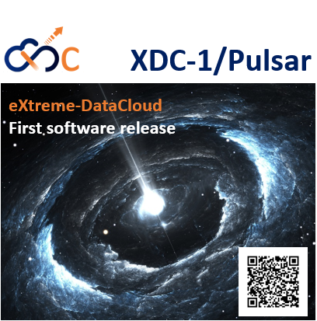
First XDC Release
Involved tools
  CachingOnDemand
  dCache
  Dynafed
  EOS
Key technical highlights
  OpenIDConnect support for token based authentication
  New QoS types integration and support in dCache, FTS, GFAL
  Orchestrator integration with other components
  Performance improvements in Onedata
  Support for groups and roles in Onedata
  EOS-dCache integration
  Caching systems instantiation
  Storage events notification in dCache
  EOS caching with XCache for geographic deployment
  EOS external storage adoption
  FTS,GFAL
  Onedata
  PaaS Orchestrator plugin
  TOSCA types & templates plugin
https://releases.extreme-datacloud.eu/en/latest/releases/pulsar/index.html

Slide 19
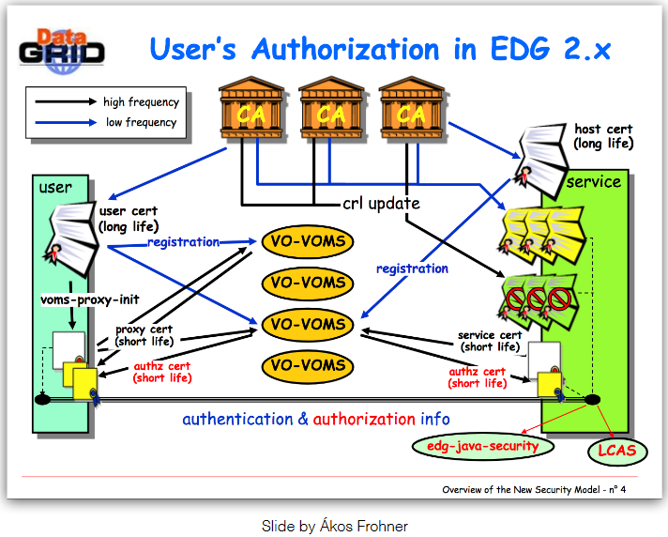
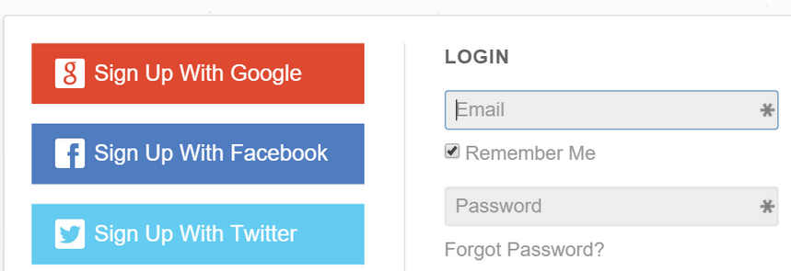
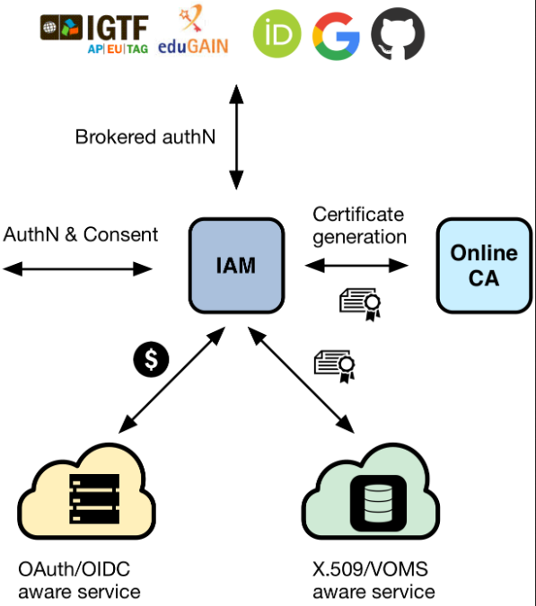

First XDC Release
Key technical highlights
  OpenIDConnect support for token based authentication
  new QoS types integration and support in dCache, FTS, GFAL
  Orchestrator integration with other components
  Performance improvements in Onedata
  Support for groups and roles in Onedata
  EOS-dCache integration
  Caching systems instantiation
  Storage events notification in dCache
  EOS caching with XCache for geographic deployment
  EOS external storage adoption
Slide by Akos Frohner ~2003
Slide by Andrea Ceccanti CHEP2018

Slide 20
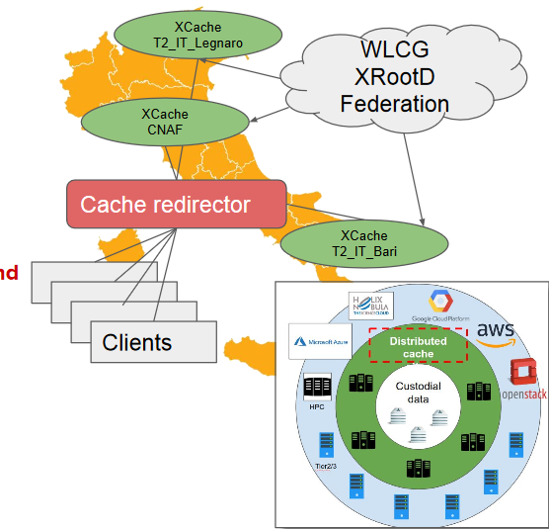
First XDC Release
Key technical highlights
  OpenIDConnect support for token based authentication
  new QoS types integration and support in dCache, FTS, GFAL
  Orchestrator integration with other components
  Performance improvements in Onedata
  Support for groups and roles in Onedata
  EOS-dCache integration
  Caching systems instantiation
  Storage events notification in dCache
  EOS caching with XCache for geographic deployment
  EOS external storage adoption
  Deployment of Geo-distributed caches
  Network of unmanaged storage for hot data
  On-demand cache resources
Slide © Diego Ciangottini
Based on xRootD/xCache
See D.Ciangottini talk on “Integration of the Italian cache federation within CMS computing model”:
https://indico4.twgrid.org/indico/event/8/session/23/contribution/45

Slide 21
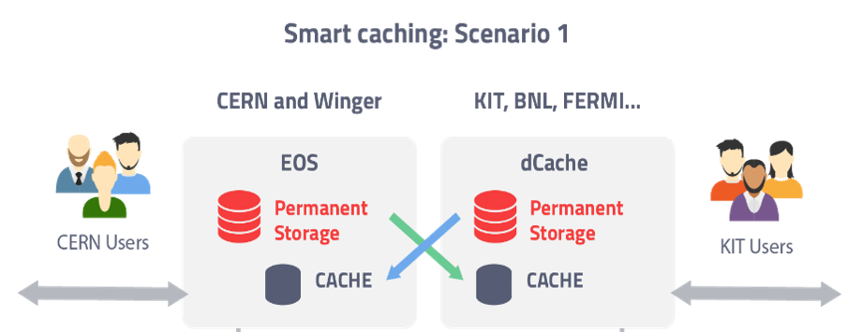
First XDC Release
Key technical highlights
  OpenIDConnect support for token based authentication
  new QoS types integration and support in dCache, FTS, GFAL
  Orchestrator integration with other components
  Performance improvements in Onedata
  Support for groups and roles in Onedata
  EOS-dCache integration
  Caching systems instantiation
  Storage events notification in dCache
  EOS caching with XCache for geographic deployment
  EOS external storage adoption

Slide 22
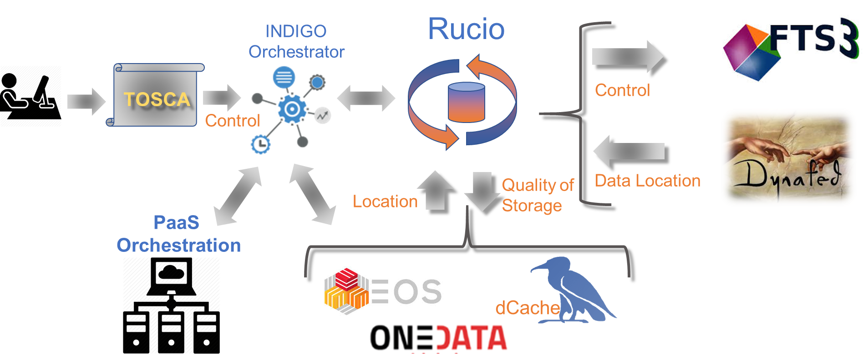
First XDC Release
Key technical highlights
  OpenIDConnect support for token based authentication
  new QoS types integration and support in dCache, FTS, GFAL
  Orchestrator integration with other components
  Performance improvements in Onedata
  Support for groups and roles in Onedata
  EOS-dCache integration
  Caching systems instantiation
  Storage events notification in dCache
  EOS caching with XCache for geographic deployment
  EOS external storage adoption

Slide 23

First XDC Release
Key technical highlights
  OpenIDConnect support for token based authentication
  new QoS types integration and support in dCache, FTS, GFAL
  Orchestrator integration with other components
  Performance improvements in Onedata
  Support for groups and roles in Onedata
  EOS-dCache integration
  Caching systems instantiation
  Storage events notification in dCache
  EOS caching with XCache for geographic deployment
  EOS external storage adoption

Slide 24
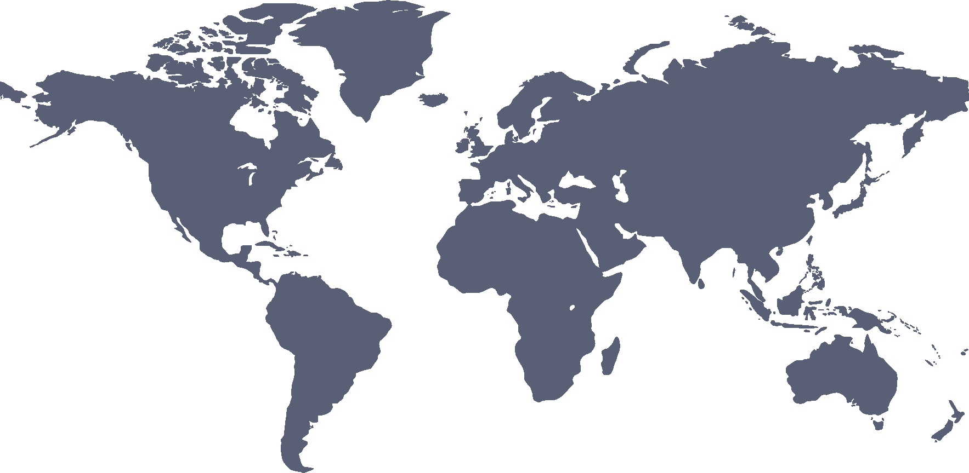

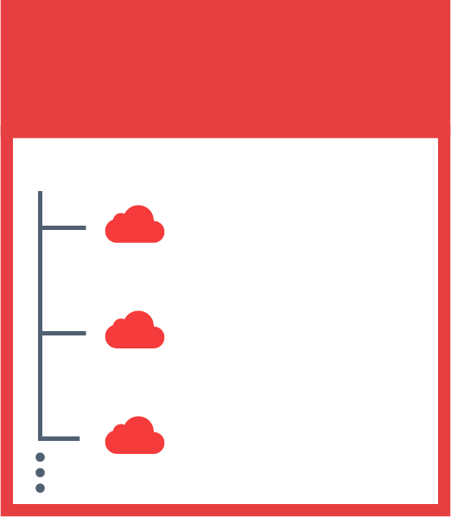

Onedata Distributed Data in Hybrid Clouds
JOHN’S SPACES
SENTINEL 2
DEEP LEARNING
SARA’S SPACES
PUBLICATIONS
SENTINEL 2
SKY MAPS
MY DATA

Slide 25





ONEDATA SYSTEM ARCHITECTURE
DS.3
Onepanel
External
SAML IdP
FUSE Client
Oneclient
Data Space 1
Onepanel
HTTP GUI
REST / CDMI
External
OIDC IdP
Onepanel
FUSE Client
Onezone
FUSE Client
P2P
Data Space 2
Onepanel
HTTP GUI
REST / CDMI
FUSE Client
Onepanel

Slide 26
Authentication and Delegation
Token based authentication (OpenID Connect, Oauth2, Macaroons)
Token based authentication using decentralized IdP infrastructures.
  Avoids the X509 management and delegation overhead.
  Will be used by WLCG in the future.
XDC Components supporting Open ID Connect
  FTS has demonstrated a transfer authorised with an OIDC access token
    Still needs token translation to X509 to support legacy storage systems
  Dynafed allows access via OIDC (redirects to the storage endpoint with same token)
    Can even translate to S3 (Signed redirection)
  Storage Endpoints: dCache, Onedata
  INDIGO PaaS orchestrator delivers OIDC tokens to FTS and Dynafed.

Slide 27
Authentication and Delegation
Token based authentication (OpenID Connect, Oauth2, Macaroons)
Macaroons
  Fast anonymous delegation token allowing caveats, like max lifetime, restricted IP range, number of accesses.
  Available already in dCache.
  Candidate for 3rd party copy with FTS and WebDAV.
Identity and Group Management
  Using the INDIGO AIM for XDC.
  Expecting WLCG to use AIM as well (decision imminent)
  We assume, our solution is compatible with the EGI Checkin.
  Demos provided by INFN
    IAM -> EGI Checkin -> home IdP or EGI SSO, for talking to the Orchestrator. Will be presented at the EOSC Hub week (Prague)
    Deployment of VMs on the EGI federated Cloud by the Orchestrator using the IAM through EGI SSO.

Slide 28
Cheat Sheet on QoS in storage
Why QoS in storage
  Different points in the data life cycle path have different requirements on the quality of the underlying storage
  Different storage providers come with different storage capabilities and consequently with different prices models
  Matching the above may safe significant resources (money)
Prerequisites
  Storage Endpoints need to understand the quality of their attached storage devices (Tape, Spinning Disk, SSD, Cloud Storage)
  Storage Endpoint must report those qualities in a standard way and must allow the quality to be chosen and should allow transitions between qualities.
  Orchestration System must be able to query the endpoints for the quality capabilities and must be able to match requirements and availabilities on the global level.

Slide 29
XDC Activities to support QoS
Building upon the work of INIDIGO DataCloud
  dCache already supports the idea of QoS, steered with REST
  INDIGO reference implementation provides a plug-in system to convert CDMI requests into REST, CEPH and GPFS calls.
  Collaboration with RDA and SNIA
XDC work with sustainability in mind.
  Agreement with CERN software providers (EOS, FTS, Rucio) and ONEDATA on a REST and CDMI core set of functionalities.
  XDC leading the WLCG DOMA working group.
    Commitment of the DOMA group (last week during the WLCG workshop) to work with XDC.
  XDC involvement in ESCAPE on the same topic.

Slide 30
Global QoS Architecture
Rucio
dCache
Merging local individual attributes to global QoS attributes.
Reporting QoS attributes
Time to first byte
Durability
Resiliency
Access Latency
Transfer Speed
***
EOS
Selecting appropriate QoS storage class
Grouping set of attributes to generic ‘community specific’ classes.
Archive
HPC
Wide Area
CEPH
Combining storage systems to fulfil the requested class
GPFS

Slide 31
Design of QoS with CDMI
High Level tools
CDMI Tools
Rest Tools
FTS, Dynafed, Rucio, Experiment Frameworks
INDIGO-DC
dCache GUI
Common IO and Control API
WLCG GFAL Library
CDMI
CDMI
I/O
Onedata
CDMI Interpreter / Engine
INDIGO CDMI Reference Implementation
REST API
Storage Layer
GPFS
CEPH
dCache
EOS

Slide 32
Caching Scenarios
Caching, depending on the use case, can significantly reduce performance degradation due to network latency.
Why do we need different caching systems?
  Caching is infrastructure and application dependent.
  Available cache systems:
    Managed secondary storage and cache
    Unmanaged cache.
Currently we provide three scenarios
  EOS with XCache
  INFN National Cache, using XCache
  dCache distributed cache. (Part of the WLCG DOMA group)

Slide 33
XDC Cache Models
Managed Storage
Unmanaged
Primary
Secondary
Cache
Cache
XCache
Network Latency
> 10 ms
> 10++ ms
> 10++ ms

Slide 34


Cache Demos (XCache Deployment)
EOS and XCache
Italian (INFN) National Cache
Legnaro
CNAF
Bologna
EOS
XCache
BARI

Slide 35

Caching for WLCG DOMA
Hamburg
Berlin
Kurchatov
Primary
Storage
Cache
Storage
Network Latency
10 ms
70 ms

Slide 36
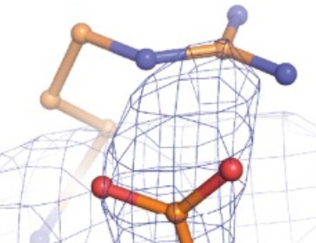


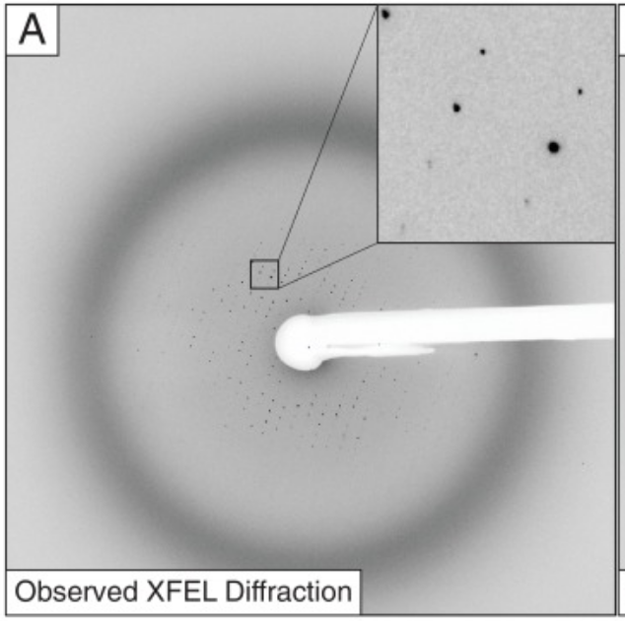
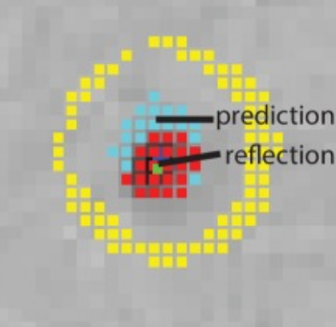
Hardwired Compute Orchestration
Event Broker
Open Stack
Dynamic
Processing
Agent
Open
Whisk
Storage
Event
plus
Authentication
(Macaroon)
Kafka
FaaS
Image
Analytics
Storage Event

Slide 37
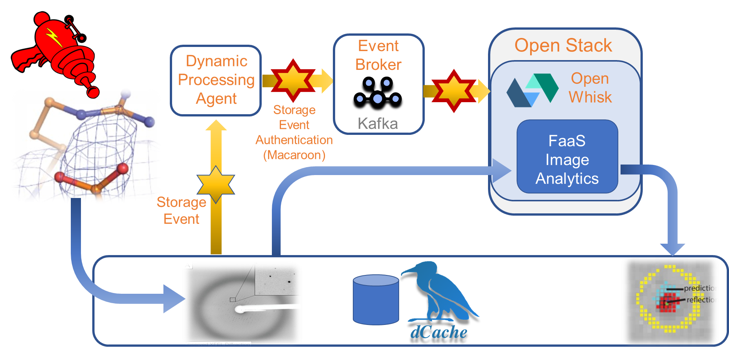
XFEL Use Case in XDC
The XFEL UseCase is driving the developments on storage events notifications support
  A reference implementation is done using dCache as backend
Refer to the Patrick’s presentation:
  https://indico4.twgrid.org/indico/event/8/session/15/contribution/9
© Patrick’s Fuhrmann

Slide 38
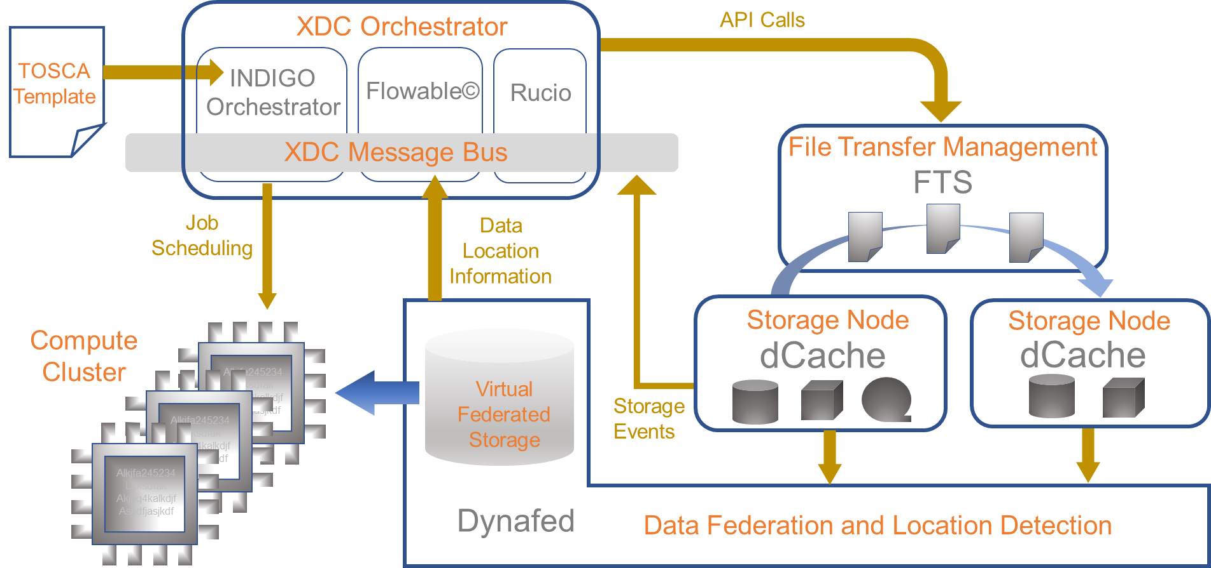
XFEL Use Case in XDC
The XFEL UseCase is driving the developments on storage events notifications support
  A reference implementation is done using dCache as backend
Refer to the Patrick’s presentation:
  https://indico4.twgrid.org/indico/event/8/session/15/contribution/9
© Patrick’s Fuhrmann

Slide 39
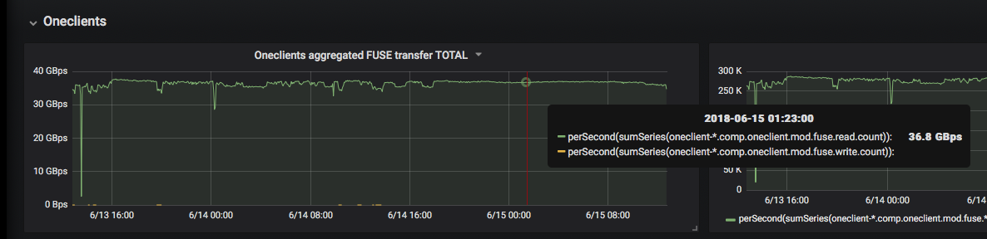
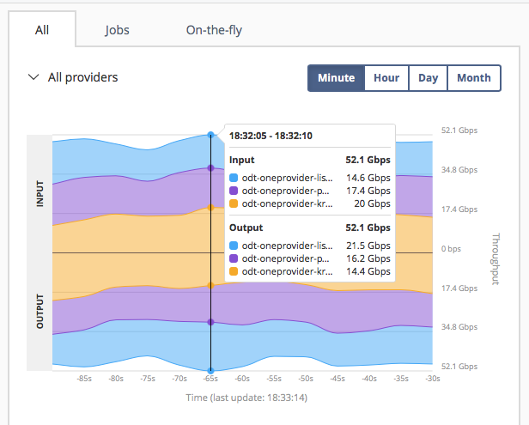
First XDC Release
Key technical highlights
  OpenIDConnect support for token based authentication
  new QoS types integration and support in dCache, FTS, GFAL
  Orchestrator integration with other components
  Performance improvements in Onedata
  Support for groups and roles in Onedata
  EOS-dCache integration
  Caching systems instantiation
  Storage events notification in dCache
  EOS caching with XCache for geographic deployment
  EOS external storage adoption
Onedata Transparent POSIX File System
Processing transparently cached data - 37GBytes/sec
Data Migration at combined
Throughput 56 Gbit/s
Data Transfer Mesh
3 Oneproviders connected by 20+Gbit/s links
Transfer data between all them
Single VM Node per Provider
Linear scalability

Slide 40
Onedata Achievements (1)
Unified data access platform for PaaS at large
  100M+ files per collection
  100GB/s range local processing throughput
  100Gbps range distributed meshed transfers
Simplified deployment
  Onedatify
  Integrated DNS and subdomain delegation
  Integrated Let’s encrypt
Onedata can be used for high throughput data acceleration at exascale level
Advanced file popularity and caching mechanism implemented
Next generation integrated GUI interface
Simplified rights management
Implemented driver for WebDAV for integration with dCache and EUDAT- B2X

Slide 41
Onedata Achievements (2)
Redesigned and reimplemented internal map reduce system for large scale indices based on single collections
Performance improvements in metadata management subsystem
Interface for external logic depending on metadata streams
Event based streams interfaces optimized and extended filtering options
Integration attributes with POSIX API (xattr command works from command line)
Public Shares integrated with DOI/PID minting

Slide 42
Onedata Achievements (3)
Prepared architecture for distributed metadata gathering and indexing
Introduction new concept at Onezone level – Harvesters
  Collecting metadata from multiple: spaces, providers
  Using external indexing services (pluggable) - at the moment Elasticsearch, but other to come like MySQL, SemanticDBs etc.
  Pluggable data discovery portal
  Detailed access control

Slide 43

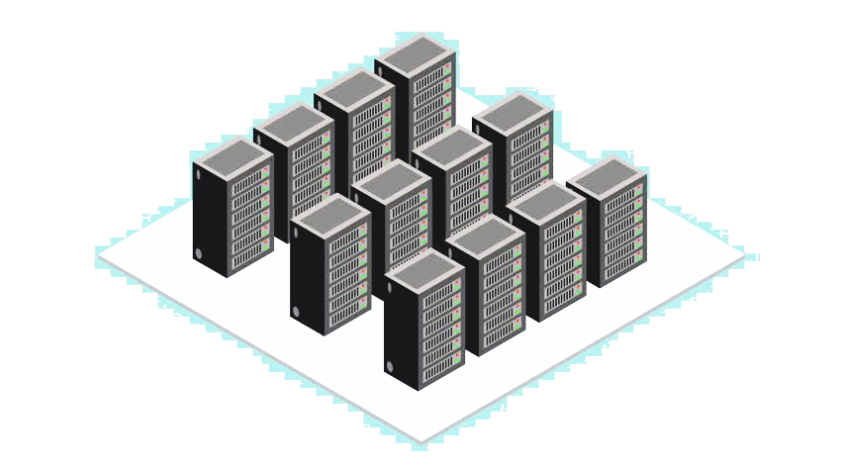
CTA Use Case Workflow in XDC
Canary Island ,
DL0/Bulk Archive x
Reconst
Calib
Online Process
Chile ,
Online Process
DL3 / High level data
20PB/yr
Max 500 files/s
Scientist Interface

Slide 44

CTA Use Case Workflow in XDC
Canary Island ,
DL0/Bulk Archive x
Reconst
Calib
Online Process
Chile ,
Online Process
DL3 / High level data
Scientist Interface

Slide 45

CTA Use Case Workflow in XDC
File System
Query by LFN
File
Generator
ingest
Metadata
Query by Metadata
Restquery
preprocessing
CTA HDF5 Extraction

Slide 46
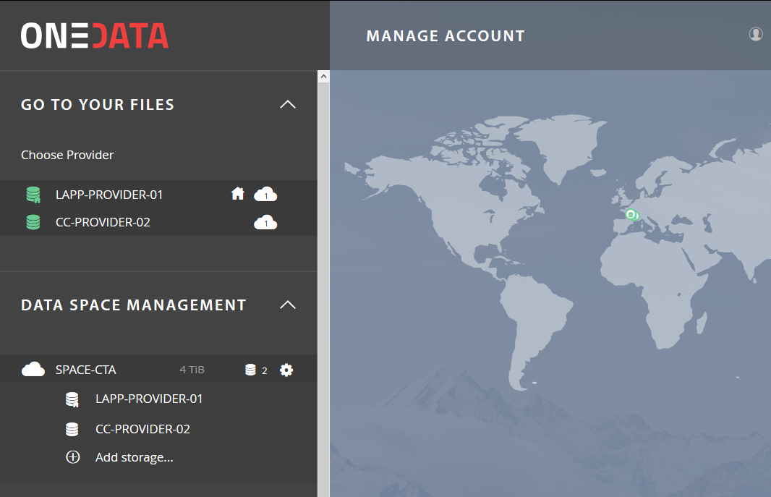
CTA Use Case Workflow in XDC
File System
Query by LFN
File
Generator
ingest
Metadata
Query by Metadata
Restquery
preprocessing
SPACE-CTA
LAPP-PROVIDER
CC-PROVIDER-02
CTA HDF5 Extraction
POSIX
40TB
S3
4TB
POSIX
6TB

Slide 47

CTA Use Case Workflow in XDC
File System
Query by LFN
File
Generator
ingest
Metadata
Query by Metadata
Restquery
preprocessing
SPACE-CTA
LAPP-PROVIDER
CC-PROVIDER-02
CTA HDF5 Extraction
POSIX
40TB
S3
4TB
POSIX
6TB

Slide 48
CTA Use Case Workflow in XDC
File System
Query by LFN
File
Generator
ingest
Metadata
Query by Metadata
Restquery
SPACE-CTA
preprocessing
LAPP-PROVIDER
CC-PROVIDER-02
CTA HDF5 Extraction
POSIX
40TB
S3
4TB
POSIX
6TB

Slide 49
CTA Use Case Workflow in XDC
File System
Query by LFN
File
Generator
ingest
All needed functionalities released with XDC-1/Pulsar
Now working on scalability
See demo at the EOSC-HUB week on next 12th April
Training on the INDIGO/DEEP/XDC Services
Metadata
Query by Metadata
Restquery
SPACE-CTA
preprocessing
LAPP-PROVIDER
CC-PROVIDER-02
CTA HDF5 Extraction
POSIX
40TB
S3
4TB
POSIX
6TB

Slide 50
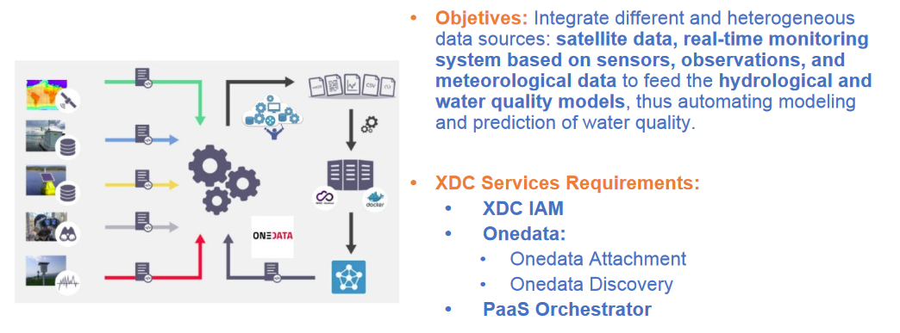
LifeWatch Use Case in XDC

Slide 51
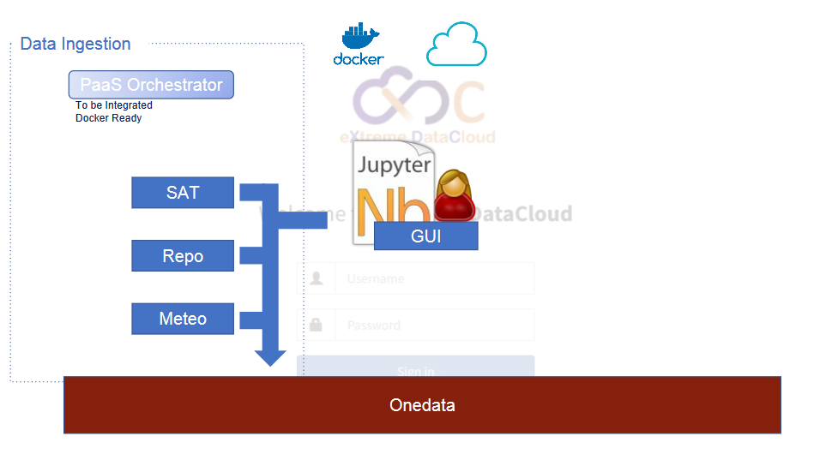
LifeWatch Use Case in XDC

Slide 52
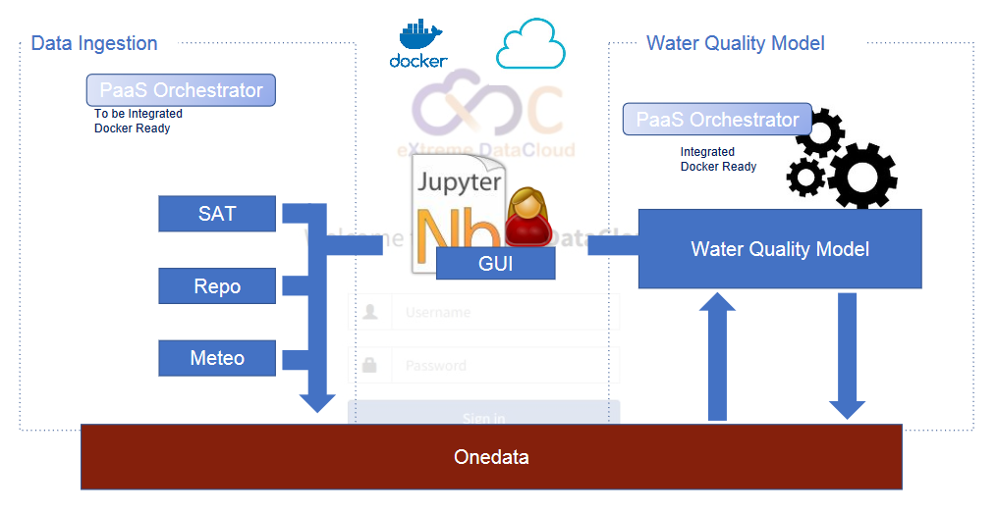
LifeWatch Use Case in XDC

Slide 53
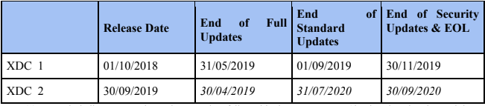
XDC Main Releases
A second major release is foreseen before the end of the project
  XDC Message bus implementation
  full orchestration
  finalize integration of RUCIO
  secure storage in Onedata
  finalize the ECRIN Use Case
  complete caching reference workflows with HTTP based systems
Jan 2018
May 2019
Sep 2019
Nov 2019
Oct 2019
Apr 2020
Jul 2020
Sep 2020
XDC products can be downloaded from XDC repositories or from each components upstream repositories after they have been pushed back

Slide 54
Conclusion
XDC is adding new functionalities to already existing, production quality, data management services
XDC-1/Pulsar was released in January 2019
  A step towards the complete implementation of the defined architecture
  Research communities can already start implementing their use cases using Pulsar
A second release is foreseen by next October
Scalability verification is in progress and will be one of the core activities in 2019
XDC consortium members will act as service providers to facilitate the uptake of the XDC services by the EOSC communities
  We are involving external service providers to increase the uptake of new user communities

Slide 55
XDC Contacts
Giacinto DONVITO
XDC – Technical Coordinator
INFN
donvito@infn.it
Website: www.extreme-datacloud.eu
@XtremeDataCloud on Twitter
Mailing list: info<at>extreme-datacloud.eu

